Slide 1
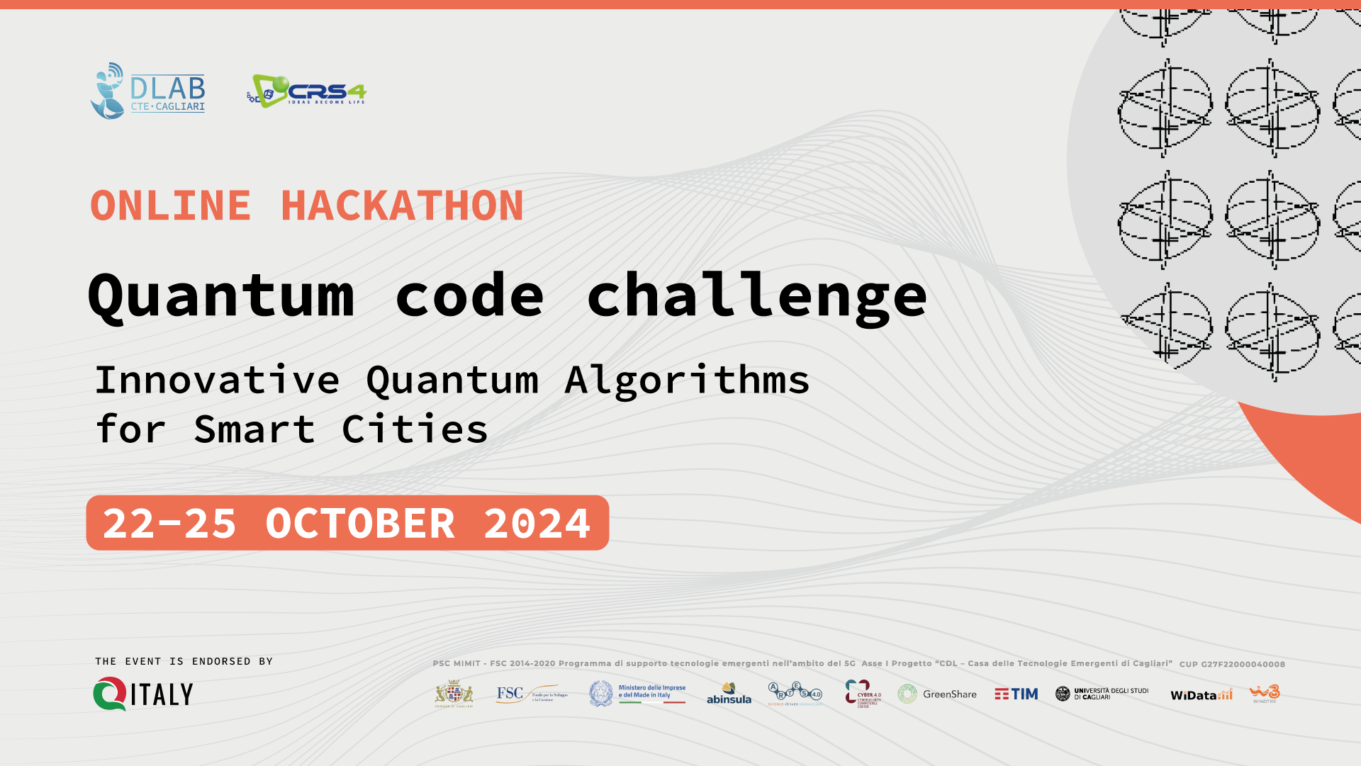

Slide 2
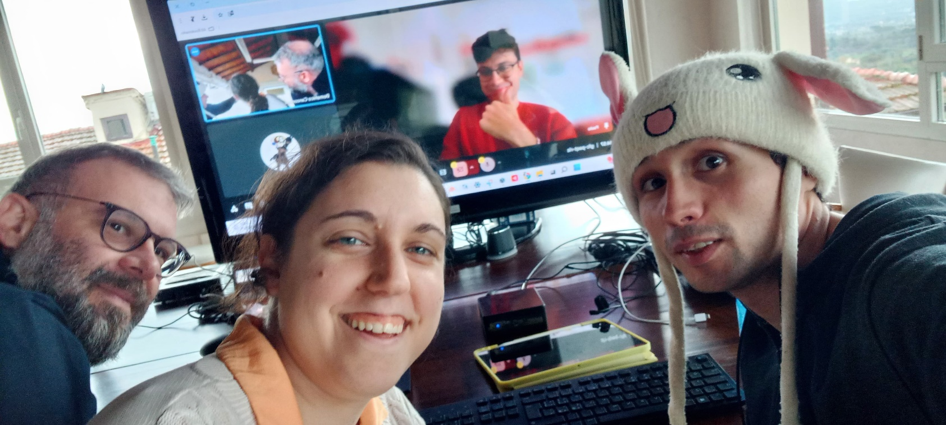

TEAM QUANT-INO
@Beatrice Donelli
@Paolo Marino
@Domenico Canzonieri
@Silviu Robert Plesoiu
https://github.com/crs4/QuantumCodeChallengeHackathon

Slide 3
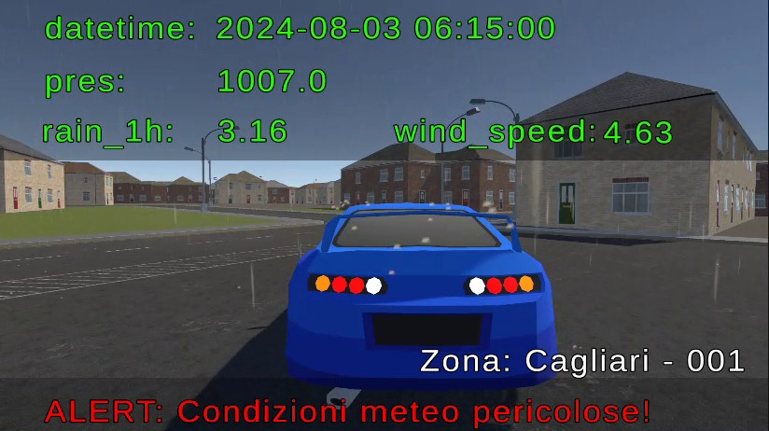
IDEA Simulation Zone: Cagliari – 001
Monitoring
https://github.com/GitPabloCode/QUANT-ino

Slide 4
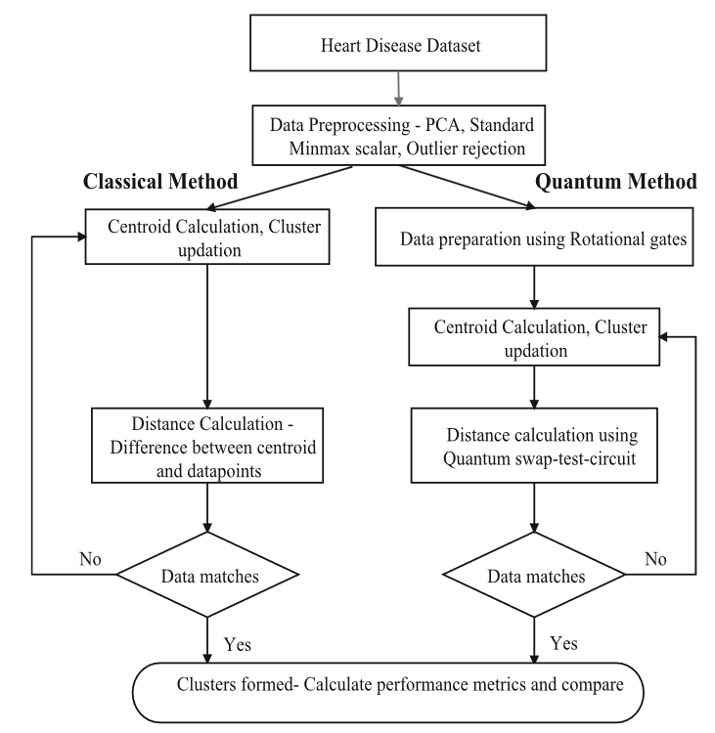
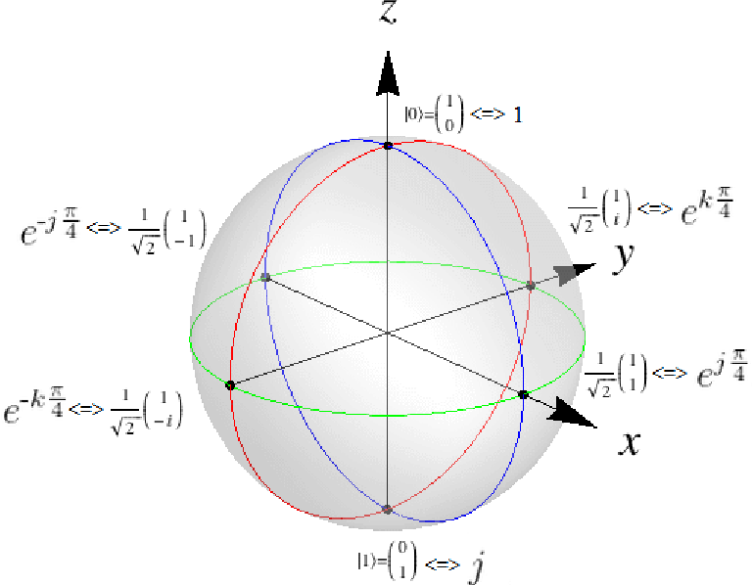
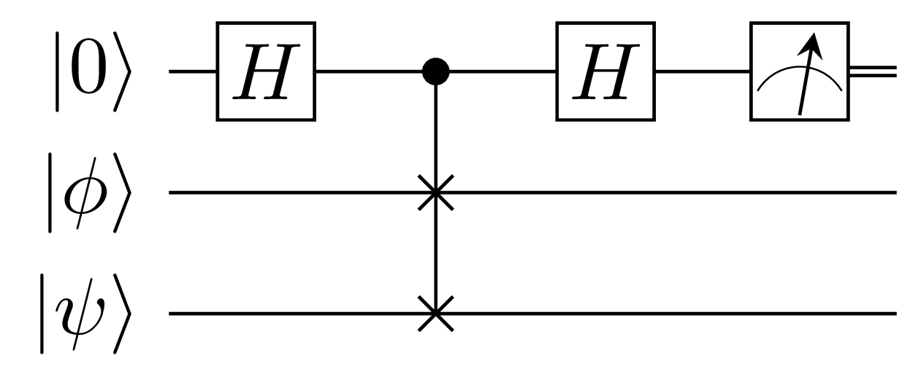
Q – means clustering
Quantum k-means clustering is optimal for unsupervised learning to detect pattern and anomalies in dataset
The proposed methodology involves preprocessing a dataset, converting the classical data to quantum states and calculating distances using a quantum circuit.
The quantum approach showed improvements in processing time and clustering performance compared to classical K-means. The results showed improved accuracy, sensitivity and reduced processing times.
Kavitha, S. S., & Kaulgud, N. (2022). “Quantum K-means clustering method for detecting heart disease using quantum circuit approach.“ In Soft Computing (Vol. 27, Issue 18, pp. 13255–13268). Springer Science and Business Media LLC. https://doi.org/10.1007/s00500-022-07200-x

Slide 5

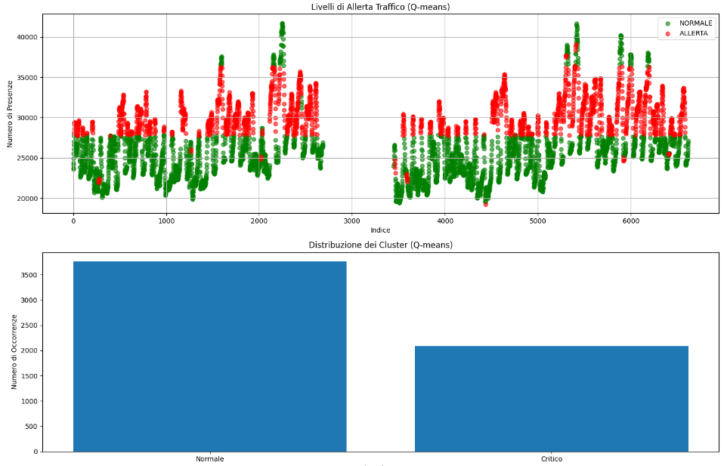
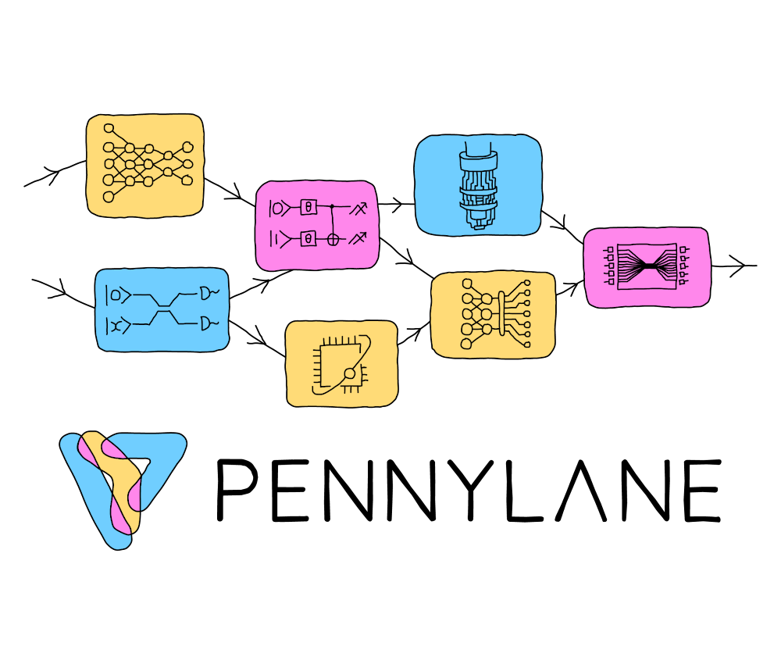
IMPLEMENTATION
https://github.com/GitPabloCode/QUANT-ino

Slide 6
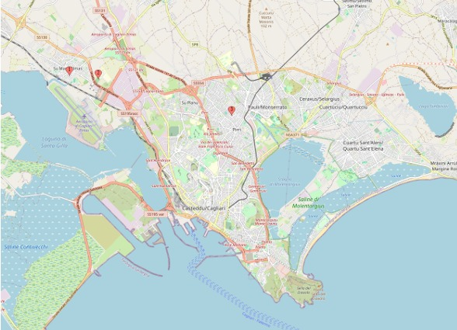
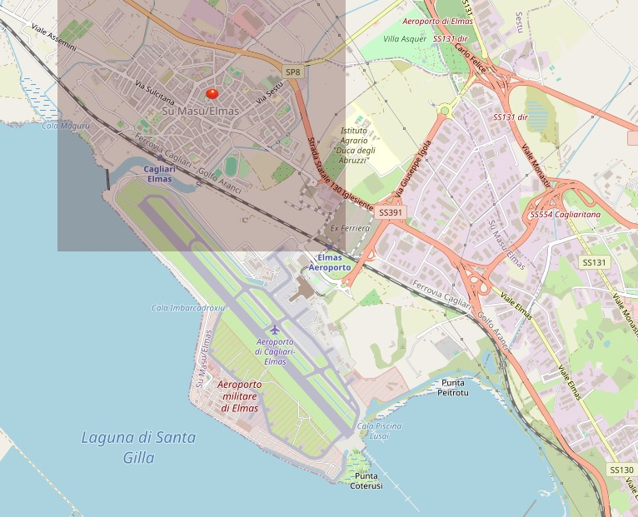

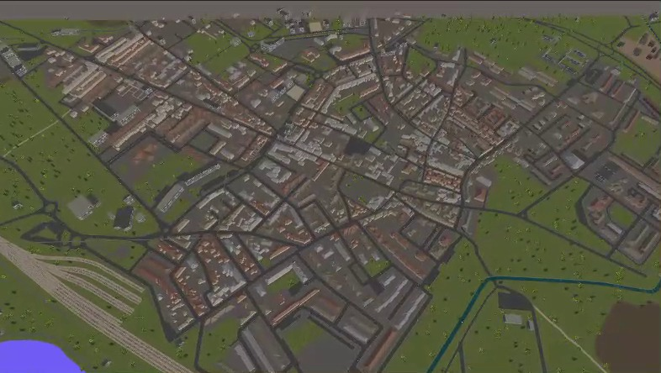

Cagliari - 001
CityGen3D is a Unity plugin for procedurally generating 3D cities using real map data such as OpenStreetMap.

Slide 7
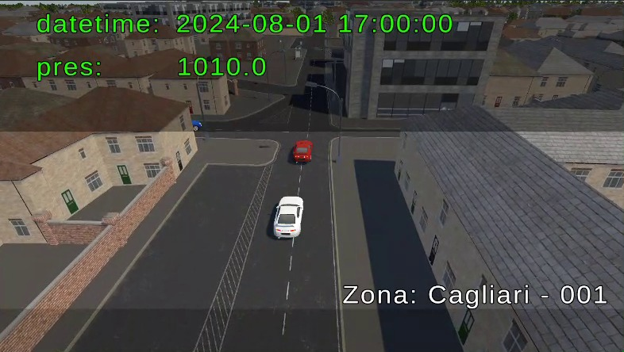

VIDEO
https://www.youtube.com/watch?v=Q6rhuSUnB9Q

Slide 8



PROPOSALS
(to improve the project)
Real time data thanks to improvement of data processing with quantum machine learning
Virtual reality application to facilitate user access to data, like police officer
Large language model to interpret data
Grover's Algorithm to enhance Q-means by accelerating centroid searches and convergence speed (using Qbraid's Nec Machine)

Slide 9
Thanks
for your attention

